Slide 1

Presented By
Sinchana AB
8th sem GECH

Slide 2


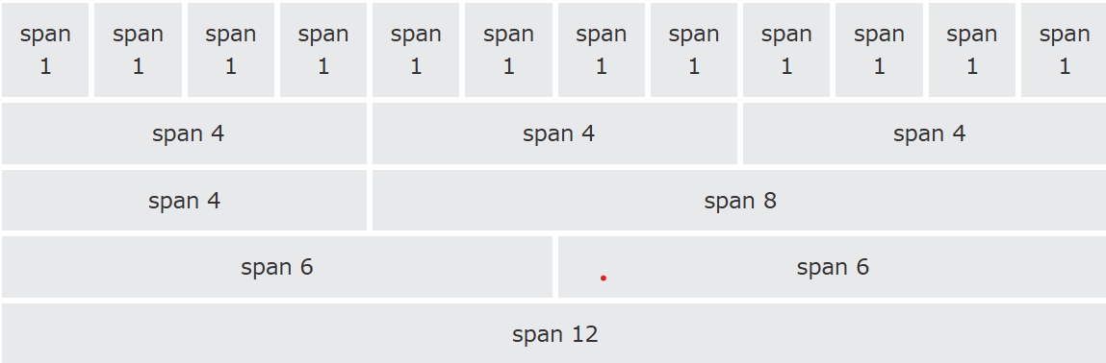
Bootstrap Grid System
•Helps design responsive web layouts.
•- Uses a 12-column system with flexbox.
•- Ensures adaptability across screen sizes.

Slide 3
Grid Classes
XS
MD
for phones - screens less than 768px wide
for small laptops - screens equal to or greater than 992px wide
Lg
for laptops and desktops - screens equal to or greater than 1200px wide
SM
for tablets - screens equal to or greater than 768px wide

Slide 4
Grid System Rules
Rows must be inside a .container or .container-fluid for proper alignment.
Use rows to group columns horizontally.
Only columns can be direct children of rows.
Use predefined classes like .row and .col-sm-4 for quick layouts
Columns have gutters (spacing) managed by row padding.
Specify column spans using a 12-column grid (e.g., .col-sm-4)
Column widths are percentage-based and adjust to their parent.

Slide 5
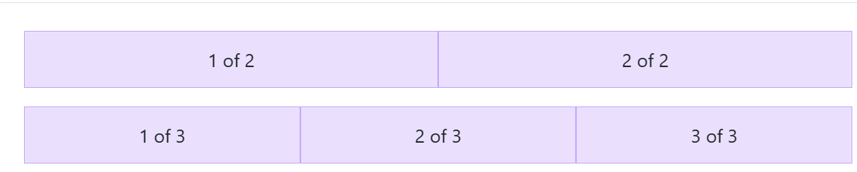
Auto-layout columns
Equal-width
Utilize breakpoint-specific column classes for easy column sizing without an explicit numbered class like .col-sm-6
<div class="container text-center">
<div class="row">
<div class="col">1 of 2</div>
<div class="col">2 of 2 </div>
</div>
<div class="row">
<div class="col"> 1 of 3</div>
<div class="col"> 2 of 3</div>
<div class="col"> 3 of 3 </div>
</div>
</div>

Slide 6
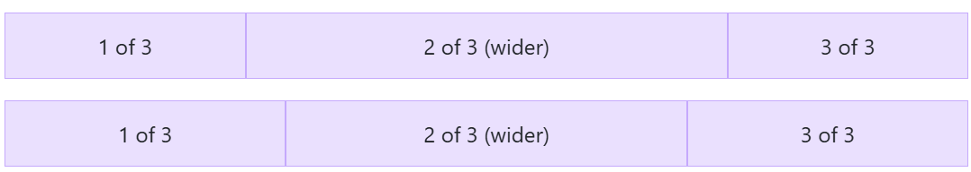
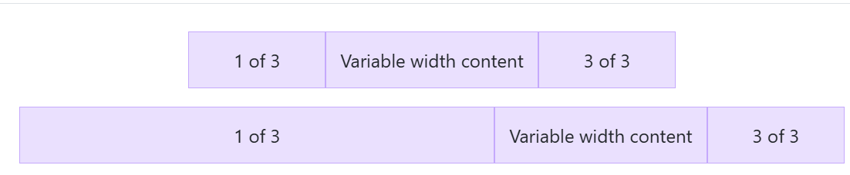
Bootstrap Grid System
Setting one column width
Variable width content

Slide 7

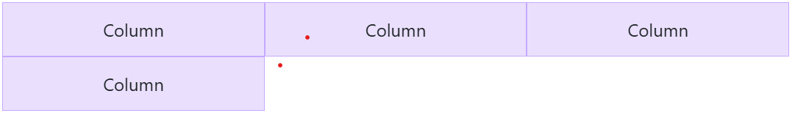
Row columns
normal .col-* classes apply to the individual columns (e.g., .col-md-4), the row columns classes are set on the parent
<div class="container text-center"> <div class="row row-cols-3"> <div class="col">Column</div> <div class="col">Column</div> <div class="col">Column</div> <div class="col">Column</div> </div></div>

Slide 8
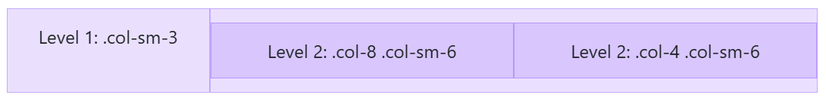
Nesting
<div class="container text-center">
<div class="row">
<div class="col-sm-3">
Level 1: .col-sm-3</div>
<div class="col-sm-9">
<div class="row">
<div class="col-8 col-sm-6">
Level 2: .col-8 .col-sm-6</div>
<div class="col-4 col-sm-6">
Level 2: .col-4 .col-sm-6
</div></div></div></div>
</div>

Slide 9
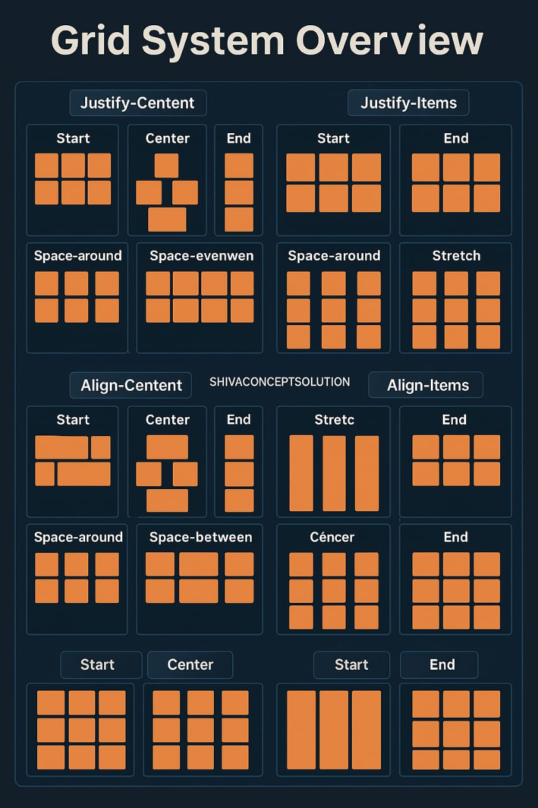

Slide 10

Thank you for listening!

